Slide 1
FLOYD’s ALGORITHM FOR ALL-PAIR SHORTEST PATH PROBLEM
Presented by:
Prof. P. M. Pujar.
Prof. N. V. Karekar.

Slide 2
Problem Definition:
Implement All-Pairs Shortest Paths Problem using Floyd's algorithm.
CSE@GIT

Slide 3
Objectives of the Experiment:
To introduce the concept of Dynamic Programming.
Present the working of Floyd’s Algorithm.
To find the shortest path between every pair of nodes in a given graph.
Analyze the Algorithm Complexity.

Slide 4
Dynamic Programming:
Dynamic Programming was invented by a prominent U.S. mathematician, Richard Bellman, in the 1950s as a general method for optimizing multistage decision processes.
The word “programming” in the name of this technique stands for “planning” and does not refer to computer programming.
Definition:
Dynamic programming is a technique for solving problems with overlapping sub problems.
Example overlapping sub problems:
The Fibonacci numbers are the elements of the sequence
0, 1, 1, 2, 3, 5, 8, 13, 21, 34, . . . ,
which can be defined by the simple recurrence
F(n) = F(n − 1) + F(n − 2) for n > 1
Dynamic programming suggests solving each of the smaller sub-problems only once and recording the results in a table from which a solution to the original problem can then be obtained.
Dynamic programming applications deal with optimization problems which uses “Principle of Optimality”.

Slide 5
Greedy Approach VS Dynamic Programming
Greedy and Dynamic Programming are methods for solving optimization problems.
Greedy algorithms are usually more efficient than DP solutions.
However, often you need to use dynamic programming since the optimal solution cannot be guaranteed by a greedy algorithm.
DP provides efficient solutions for some problems for which a brute force approach would be very slow.
To use Dynamic Programming we need only show that the principle of optimality applies to the problem.

Slide 6
Theoretical Background
Principle of Optimality:
An optimal policy has the property that
“ Whatever the initial state and initial decision are, the remaining decisions must constitute an optimal policy with regard to the state resulting from the first decision “.

Slide 7
Theoretical Background:
Underlying Idea of Floyd’s Algorithm
The idea of Floyd’s algorithm is similar to Warshall’s Transitive Closure
Transitive Closure:
If there exists an edge between V_{i} and V_{k} and also between V_{k} to V_{j} then there is an edge between V_{i} and V_{j}
V^{(k-1)}_{ij}
i
j
V^{(k-1)}_{ik}
V^{(k-1)}_{kj}
k

Slide 8
Theoretical Background of All Pair shortest path
The problem: find the shortest path between every pair of vertices of a graph
The graph: may contain negative edges but no negative cycles
A representation: a weight matrix where W( i, j)=0 if i=j. W( i, j)=∞ if there is no edge between i and j. W( i, j)=“weight of edge”

Slide 9
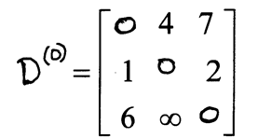
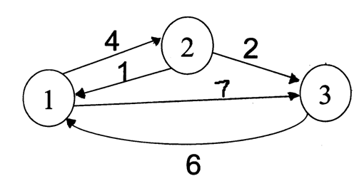
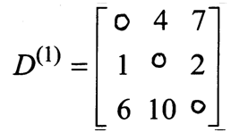
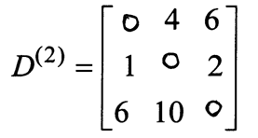
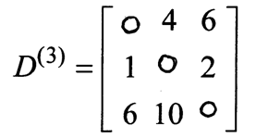
Floyd’s Algorithm – Example1
Original weights.
Consider Vertex 1:
D(3,2) = D(3,1) + D(1,2)
Consider Vertex 2:
D(1,3) = D(1,2) + D(2,3)
Consider Vertex 3:
Nothing changes.

Slide 10
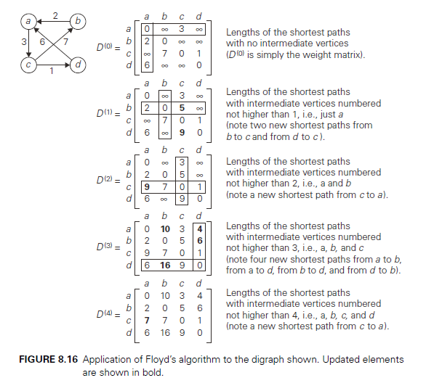
Floyd’s Algorithm – Example2

Slide 11
ALGORITHM Floyd(W[1..n, 1..n],n)
//Implements Floyd’s algorithm for the all-pairs shortest-paths problem
//Input: The weight matrix W of a graph with no negative-length cycle
//Output: The distance matrix of the shortest paths’ lengths
D ←W // Distance matrix equals Weight matrix
for k←1 to n do //k is intermediate node
for i ←1 to n do // i is source node
for j ←1 to n do // j is destination node
D[i, j ]←min{D[i, j ], D[i, k]+ D[k, j]}
return D
Initial Call: Floyd(W[ ][ ], n)

Slide 12
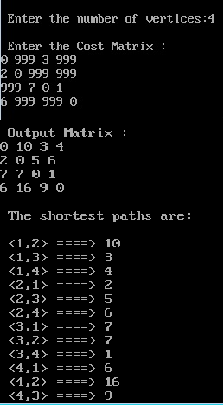
Floyd’s Algorithm – Sample Output

Slide 13
Efficiency of Floyd’s Algorithm
Worst-case performance | Θ ( | V | ³ )
Best-case performance | Θ ( | V | ³ )
Average performance | Θ ( | V | ³ )

Slide 14
Illustration of the All-Pair Shortest Path Algorithm
Animated video

Slide 15
Learning Outcome of the Experiment and Conclusion
At the end of the session, students should be able to :
Explain the working of Dynamic Programming.
[L2, CO 2, PO1]
2. Demonstrate the working of Floyd’s algorithm.
[L3, CO 2, PO3]
3. Analyze the complexity of the algorithm. [L3, CO 2, PO3]

Slide 16
THANK YOU…..

